Slide 1
Amazon Web Services Certification Guide

Slide 2
Amazon Web Services Certification: Overview
Through the Accenture-Amazon Web Services Business Group (AABG), Accenture individuals have access to a wide range of Amazon Web Services (AWS) certification support materials.
This guide describes the following path to certification:
Identify the Certification you intend to pursue
Prepare for your exam
How to access AWS Preparation materials
How to obtain access to QWIKLabs Credits
How to obtain access to Cloud Academy resources
How to obtain access to exam vouchers and service credits
Register for your exam
Pass your exam and register in myCertification
Key Contacts

Slide 3
Identify the Certification you intend to pursue

Slide 4
Roadmap Summary
Identify the certification
Ensure you meet pre-requisites
Prepare for your exam
Take a practice exam
Take the certification exam

Slide 5
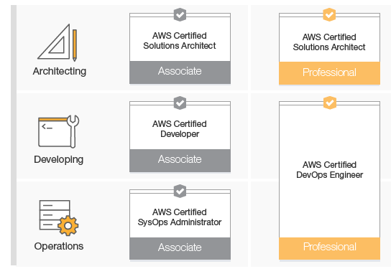
Amazon Web Services Certification Overview
Identify the type of certification you intend to pursue and review the Certification Overview, which describes pre-requisite criteria:
Certified Solution Architect-Associate (https://aws.amazon.com/certification/certified-solutions-architect-associate/)
Certified SysOps Administrator-Associate (https://aws.amazon.com/certification/certified-sysops-admin-associate/)
Certified Developer-Associate-(https://aws.amazon.com/certification/certified-developer-associate/)
Certified Solution Architect-Professional (https://aws.amazon.com/certification/certified-solutions-architect-professional/)
Certified DevOps Engineer-Professional (https://aws.amazon.com/certification/certified-devops-engineer-professional/)
Certifications are valid for 2 years, at which time they must be renewed.
If you need to get re-certified, follow the guidance at this link. (https://aws.amazon.com/certification/recertification/)
Please review these slides carefully and follow the instructions sequentially.
Also note, reimbursement for vendor-provided certification requires approval in myLearning. Please ensure that you follow the steps necessary to obtain this approval or risk being required to pay for this certification personally (see the next slide in this deck on obtaining certification support and certification exam vouchers).
If you have any questions or concerns, refer to the last page in this guide for contacts.

Slide 6
Prepare for your exam

Slide 7
How to Access AWS Preparation Materials
Amazon Web Services provides access to a number of free certification prep resources. You can access these at the following links:
Exam Guides for each certification (https://aws.amazon.com/certification/certification-prep/)
Sample question set for each certification (https://aws.amazon.com/certification/certification-prep/)
AWS Whitepapers on specific topics (https://aws.amazon.com/whitepapers/)
AWS FAQs on specific services (https://aws.amazon.com/faqs/)

Slide 8
How to obtain access to QWIKLabs
QWIKLabs provide hands-on, real time exposure to key concepts. You can learn more about QWIKLabs at this link (https://qwiklabs.com/?locale=en)
QWIKLabs provides ‘Quests’ that guide you through labs designed to support specific certifications.
You may be able to obtain QWIKLabs credits when you are within 60 days of sitting for your exam.
To request access to QWIKLabs credits, submit the following information to jeff.Hammond@accenture.com
Enterprise ID
Type of Certification you are pursuing
Target date for obtaining certification
The enterprise ID or email of your training approver
Pre-requisite training you have completed
You will then receive an email from QWIKLabs notifying you that credits are available for your use along with a link to access QWIKLabs.
NOTE: You must access QWIKLabs using your Accenture ID to use the credits.

Slide 9
How to obtain access to Cloud Academy
Cloud Academy is a self-help portal containing learning paths, self-study courses, labs, quizzes and more. You’ll be able to develop AWS skills, prepare for certifications and gain hands on experience via an online, self-study environment.
Accenture has an agreement to provision a limited number of licenses at a special rate. When these licenses are available, registration for Cloud Academy is handled the same way as any course through myLearning myLearning
Course # A26612
Course Name: Cloud Academy for AWS
Course Link: https://mylearning.accenture.com/Atlas/home.aspx?url=%23%2FactivityDetailsqmqmactivityID%3D1365174%26activitySource%3DLMS
Once you register, your training approver must authorize access. When your training approver authorizes your registration, the tuition is charged to your training wbs.
You will receive email notifications that you have been granted access to the Cloud Academy
In myLearning, click ‘Start’, enter your Accenture Enterprise ID and Password and you will be directed to the Accenture Global Dashboard of Cloud Academy.

Slide 10
Access to other 3rd Party certification preparation resources
In some circumstances, you may wish to pursue alternative 3rd party exam preparation resources.
Currently, AABG identifies the following 3rd party resources as valid:
Cloud Academy (see prior slide for information)
ACloudGuru
Linux Academy
Individuals wishing to access these 3rd party platforms should ‘Register for external training’ in myLearning.
Upon approval of the registration, individuals may expense the license cost using the training WBS provided upon authorization.

Slide 11
How to access Exam Vouchers and Service Credits
Exam vouchers take three forms:
Practice exam vouchers
Full exam vouchers (Both professional and associate levels)
AWS service credits (applied to individual AWS accounts for practicing with AWS services)
Pre-requisite(s)
To obtain an associate certification voucher, you must first have attended a relevant training course in the prior 18 months (currently this includes Architecting for AWS, Developing on AWS, or SysOps Administration on AWS). In some cases and exception can be made for significant hands on experience or formal training completed through approved 3rd party platforms.
If you are pursuing Professional Certification, you must have already received an associate level certification.
If you meet the pre-requisite, then the process for obtaining vouchers and service credits is as follows:
When you are within 45 days of taking the final exam, send the following information to Ritu Eapen (ritu.eapen@Accenture.com) with cc to: Jeff Hammond jeff.Hammond@accenture.com
Enterprise ID
Your Training Approver
The date by which you intend to complete certification
The type of certification you intend to pursue (ie. Associate or Professional level Solutions Architect, Developer, SysOps Administrator, or DevOps Engineer [Professional only])
Confirmation of the pre-requisite training you attended
If you are pursuing Professional Certification Exam vouchers, submit the associate certification you possess and date obtained
You will receive a practice exam voucher, which you must use within 15 days.
Take and pass your practice exam
Send confirmation of passing your practice exam to Ritu Eapen (ritu.eapen@Accenture.com) with cc to: Jeff Hammond jeff.Hammond@accenture.com
You will then receive a voucher for the relevant exam (professional or associate level) that you are taking, which you must use within 30 days.
Schedule your exam using the voucher
Pending availability, you can request AWS service credits that you can use to practice prior to your exam.
If you are unable to take the exam as scheduled, or if you are unable to use the service credits, please reach out to Ritu Eapen (ritu.eapen@Accenture.com) with cc to: Jeff Hammond jeff.Hammond@accenture.com

Slide 12
Register for your Certification Exam

Slide 13
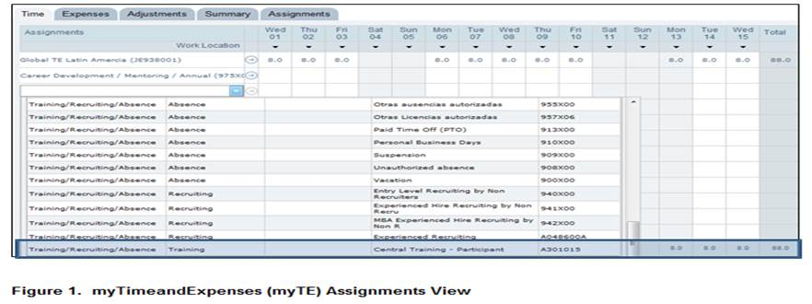
Amazon Web Services Certification Step 1: Register for Certification in myLearning
Please use the links below to register for the respective certification in myLearning. Complete the Vendor Training Request (VTR) form that opens up. In the charge code field, enter your DTE-specific, 8-digit WBSE number. For a missing training DTE-specific WBS Element value in myLearning reach out to your local HR resource.
AWS Certified Solutions Architect - Associate Level
AWS Certified Developer - Associate Level
AWS Certified SysOps Administrator - Associate Level
AWS Certified Solutions Architect or DevOps - Professional Level
Charging Training Time & Claiming Certification Expenses in myTE Application For charging your time and to claim certification expenses please use the WBSE as explained below.
myTimeandExpenses has a system change that only allows you to submit Central Training Course Time and Expense charges against the “Central Training – Participant” Static Project number. Select the relevant “Central Training – Participant” Static Project numbers from the myTE Assignments drop down view (Figure 1).
NOTE: The name of this Assignment may vary depending on the country you are based in. For assistance, please contact your Local TE Functional Support.

Slide 14
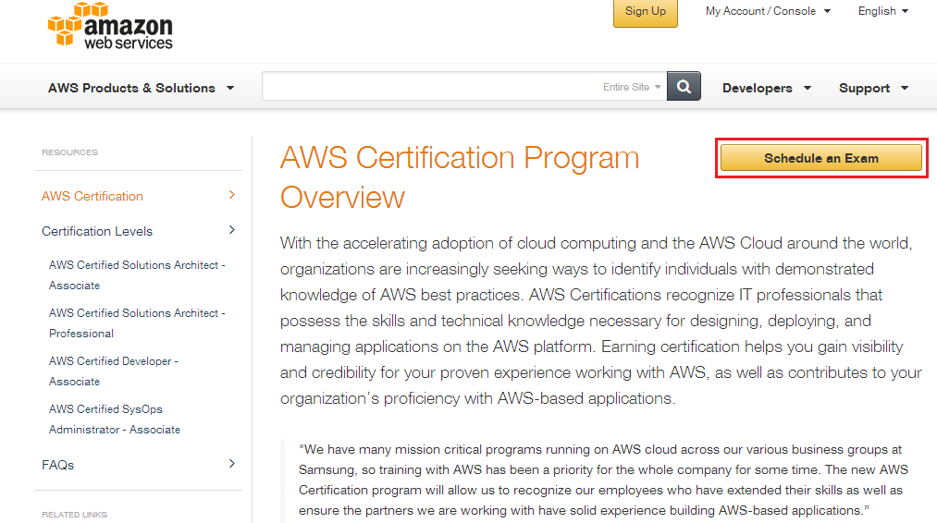
Amazon Web Services Certification Step 2: Go to the AWS Certification Page
After registering in myLearning and obtaining approval to take AWS certification, follow these steps:
Go to http://aws.amazon.com/certification/
Click the Schedule an Exam button

Slide 15
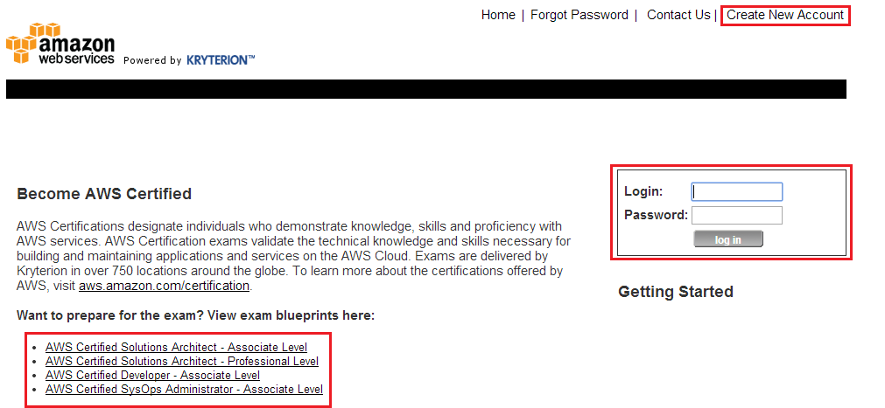
Amazon Web Services Certification Step 3a: Login to the AWS WebAssessor / Kryterion Website
If you already have an AWS WebAssessor / Kryterion account, use the login boxes and advance to Step 3c.
Otherwise, click Create New Account and continue to Step 3b.
NOTE: This page also includes links to valuable exam blueprints, study guides. These are highly recommended.

Slide 16
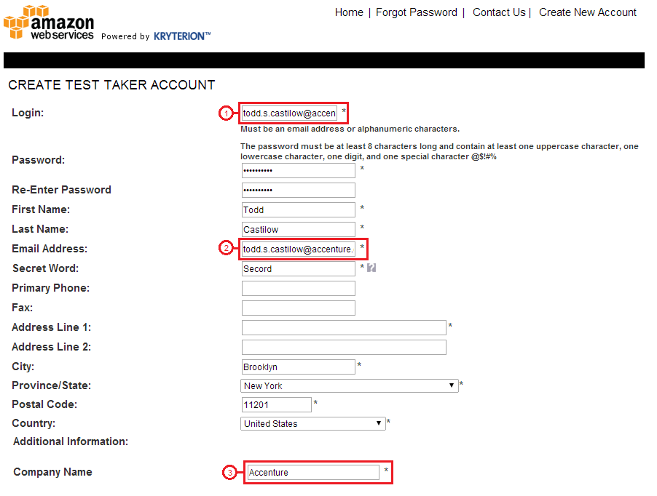
Amazon Web Services Certification Step 3b: Create a New Account at AWS WebAssessor / Kryterion
:
Create a new account by completing the form with your information, noting the following:
Login You may use any login name you desire. You can provide an email address although this is not an address that will be used to send email to you.
Email Address This must be your Accenture email address. We need this to effectively track who is certified within Accenture.
Company Name This must be listed as “Accenture” so that we can readily determine how many people are certified.
After completing this step, proceed to Step 4 on slide 16

Slide 17
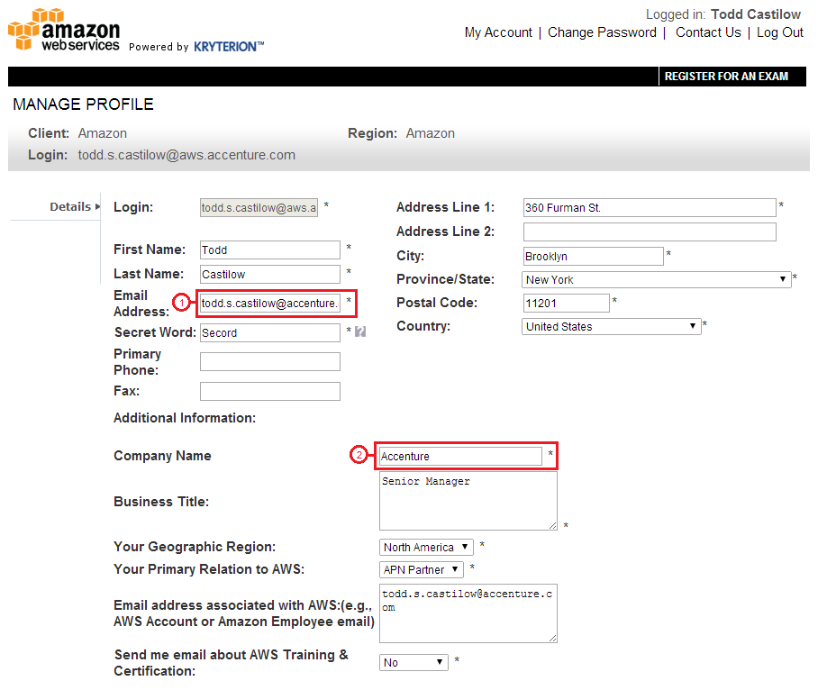
Amazon Web Services Certification Step 3c: Confirm Employer and Email Address
.
After you login, click My Account to confirm that your email address and employer information is listed correctly
Address This must be your Accenture email address. We need this to effectively track who is certified within Accenture.
Company Name This must be listed as “Accenture” so that we can readily determine how many people are certified.

Slide 18
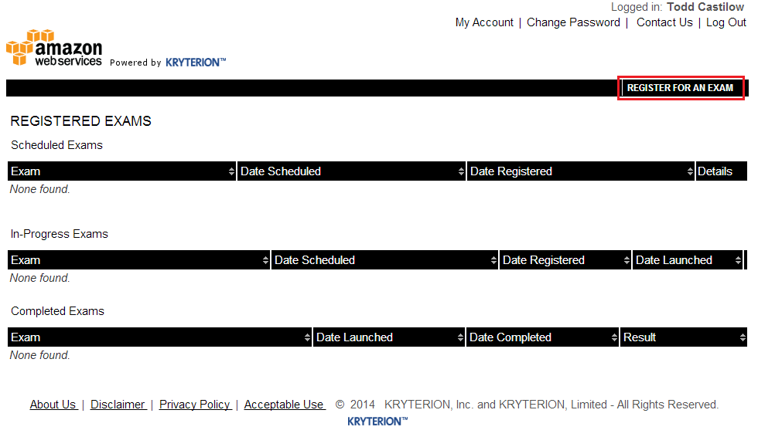
Amazon Web Services Certification Step 4: Register for an Exam
Once you’re logged in and confirmed that you’re properly registered, complete the following steps.
Click Register for an Exam (see screenshot below)
Choose the appropriate exam and language and choose Buy Now.
Select an appropriate testing location, date and time and proceed to Step 5.

Slide 19
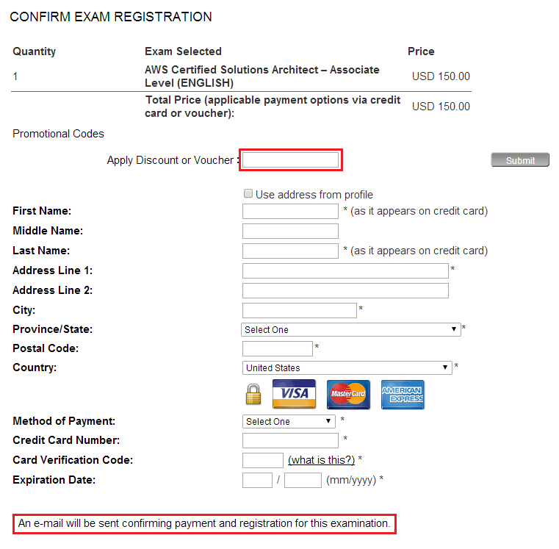
Amazon Web Services Certification Step 5: Complete Registration
To complete registration, enter your address and payment information using your corporate or personal credit card.
If you received a voucher as a result of registration in myLearning, or through the process identified in this guide, enter this in the appropriate box (see below),otherwise please leave this field blank.
Also note that an email confirmation will be sent to you.
Forward your email confirmation to aws.training@accenture.com since Amazon frequently provides AWS credits to those who register for certification and we’d like to ensure our personnel avail themselves of this opportunity.

Slide 20
Pass your exam and register in myCertification

Slide 21
Pass your exam and register in myCertification
Once you have successfully passed your certification exam, you should:
Login into https://mycertification.accenture.com
In the search box, enter ‘Amazon’
Under the list of available certifications, choose the certification that you have successfully obtained and click ‘Register’
Click the ‘Components’ tab
Expand the ‘Evidence of Certification’ section and click the ‘Evidence of Certification’ component appearing within this section
Complete and submit the Evidence of Certification (EoC) form
After submitting the EoC form, your request will be sent for approval by the Accenture-AWS Business Group. Upon approval of your submission, the following will take place:
your completion status will be updated within three business days.
your credential will appear in your Accenture CV-Resume within two weeks.
your credential will be added to your People Page within two weeks.
If you have any questions, please reach out to the ‘Contact Us’ option on the right side of the myCertification page.

Slide 22
Contacts

Slide 23
Amazon Web Services Certification
If you have any questions or concerns you may contact any of the following:
AWS.Training, AWS Training Shared Mailbox
Certification Exam Vouchers/Service Credits
Ritu.Eapen@Accenture.com
Jeff.Hammond@accenture.com
QWIKLabs Credits
Jeff.Hammond@accenture.com
Cloud Academy Access
Ritu.Eapen@Accenture.com
Jeff Hammond, AABG, Capability Enablement Lead
Randy Sheetz, AABG, Cloud Alliance Lead
Neelima Vaid, Learning & Talent Development Lead (AWS, Cloud & Microsoft)

